Slide 1


Dept of AIML

Slide 2
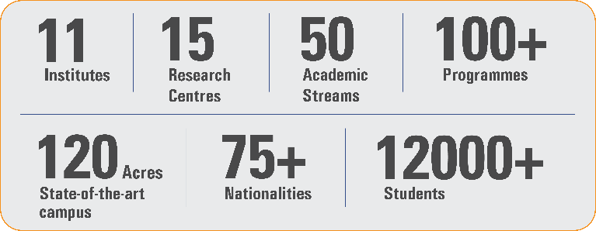
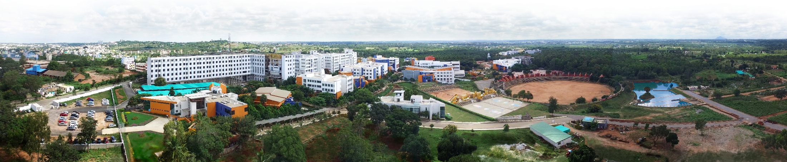
Overveiw
Acharya stands as a beacon of excellence in higher education, boasting a legacy of academic distinction since its establishment in 1990. We offer a transformative educational experience, fostering holistic development, nurturing innovation and providing world-class facilities to ensure an enriching journey for our students.
Dept of AIML

Slide 3
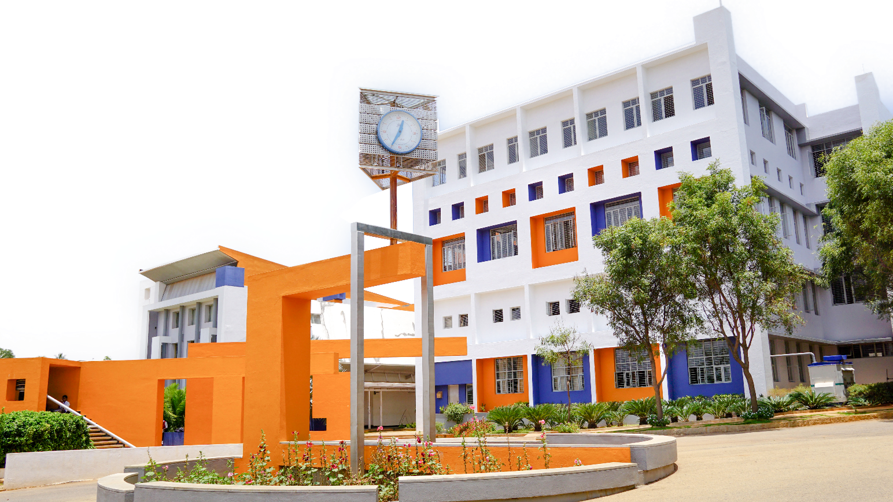
11 Institutions, Infinite Possibilities
We provide 100+ programs across 50 academic streams.
Dept of AIML

Slide 4
Cloud Computing and Security (BIS613D)
MODULE-1
Distributed System Models and Enabling Technologies:
Scalable Computing Over the Internet
Technologies for Network-Based Systems
System Models for Distributed and Cloud Computing
Software Environments for Distributed Systems and Clouds
Performance Security and Energy Efficiency.
Dept of AIML

Slide 5
Module Learning Objectives
Understand the evolution of distributed computing
Differentiate HPC, HTC, clusters, grids, P2P, and cloud systems
Explain enabling technologies for network-based systems
Analyze performance, security, and energy efficiency challenges
Identify modern distributed programming models
Dept of AIML

Slide 6
Scalable Computing over the Internet
The Age of Internet Computing
Over the last few decades, computing shifted from centralized mainframes to large-scale Internet-based systems. The growth of:
Massive data generation
Millions of concurrent users
Web services and cloud platforms
has transformed computing into a data-intensive and network-centric discipline.
Earlier performance measurement relied on the Linpack benchmark (HPC focus). Today, computing must also satisfy High Throughput Computing (HTC) requirements.
Dept of AIML

Slide 7
Evolution of Distributed Computing
Shift from centralised mainframes to distributed Internet systems
1950–1970 – Mainframes (e.g., IBM 360): Used by big companies and governments.
1960–1980 – Minicomputers (e.g., PDP-11): Used in colleges and small businesses.
1970–1990 – Personal Computers: Built using microprocessors (VLSI).
1980–2000 – Portable Devices: Laptops, mobiles in wired/wireless networks.
Since 1990 – Clusters, Grids & Clouds: Use High Performance and High Throughput system
Dept of AIML
Key Shift:
From centralized computing → to parallel and distributed computing → to cloud computing and IoT

Slide 8
Evolution of Distributed Computing
Era | Technology | Characteristics
1950–1970 | Mainframes | Centralized computing
1960–1980 | Minicomputers | Reduced cost, wider access
1970–1990 | Personal Computers | Microprocessor-based
1980–2000 | Portable & Networked Devices | Wired & wireless
1990–Present | HPC, HTC, Clusters, Clouds | Internet-scale computing
Dept of AIML

Slide 9
Evolution of Distributed Computing
Distributed Computing: A collection of independent computers that work together as a single coherent system.
Mainframes (1960s)
↓
Clusters (1980s)
↓
Grid Computing (1990s)
↓
Cloud Computing (2006+)
KEY MILESTONES
• 1960s: ARPANET (Internet precursor)
• 1980s: MPI, PVM standards
• 1990s: Globus Toolkit (Grid)
• 2006: AWS EC2 launch [file:4]
Dept of AIML

Slide 10
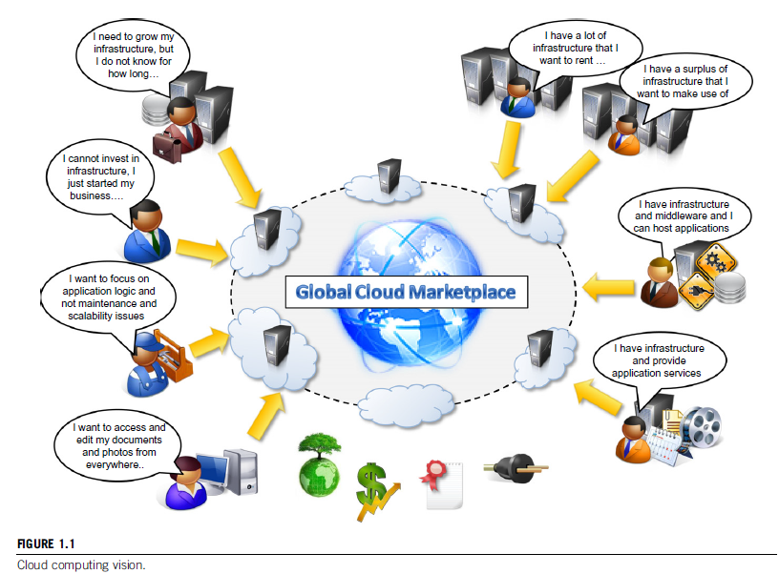
Dept of AIML

Slide 11
Scalable Computing Over the Internet
A cloud is a type of parallel and distributed system consisting of a collection of interconnected and virtualized computers that are dynamically provisioned and presented as one or more unified computing resources based on service-level agreements established through negotiation between the service provider and consumers.
Dept of AIML

Slide 12
Scalable Computing Over the Internet
Scalable computing is meant for:
Solving big problems efficiently by using many computers connected through the Internet.
Instead of using one single centralized computer, we now use parallel and distributed systems to handle large-scale tasks.
These systems have improved the quality of modern life by powering services like Google Search, social media, online shopping, and more.
Dept of AIML

Slide 13
Scalable Computing Over the Internet
Uses multiple autonomous computers
Solves large-scale problems collaboratively
Characteristics:
Data-intensive
Network-centric
Parallel & distributed execution
Dept of AIML

Slide 14
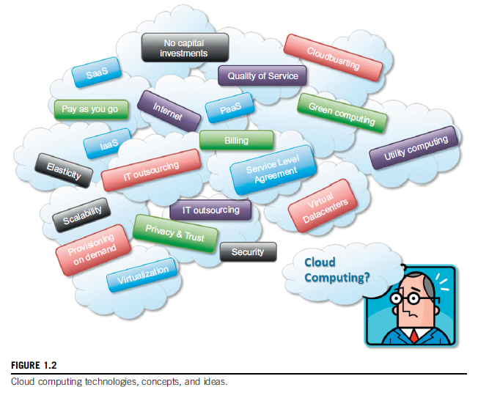
Scalable Computing Over the Internet
Dept of AIML

Slide 15
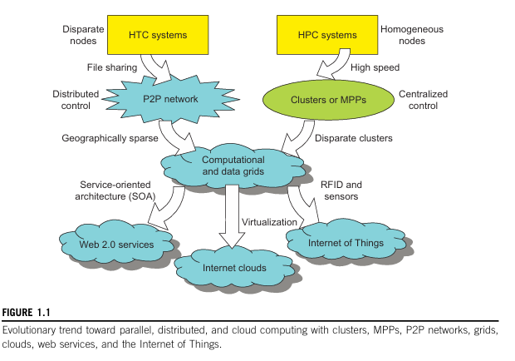
Scalable Computing Over the Internet
Dept of AIML
Massively Parallel Processors (MPP)

Slide 16
Scalable Computing Over the Internet
High-Performance Computing (HPC)
Focuses on speed and raw power.
Used in scientific simulations, engineering, weather forecasting, etc.
Measured in floating point operations per second (FLOPS).
Examples: Supercomputers.
Dept of AIML

Slide 17
HPC vs HTC Paradigm
High Performance Computing (HPC)
Focus: Raw speed
Metric: FLOPS (Floating Point Operations Per Second)
Applications:
Scientific simulations
Weather forecasting
Genomics
Engineering design
Supercomputers evolved from:
Gflops (1990s)
Pflops (2010)
Dept of AIML

Slide 18
High-Throughput Computing (HTC)
High-Throughput Computing (HTC)
Focuses on completing many tasks at once.
Used in web services, search engines, data centers.
Measures number of jobs completed per second.
Prioritizes cost, energy efficiency, and reliability.
Dept of AIML

Slide 19
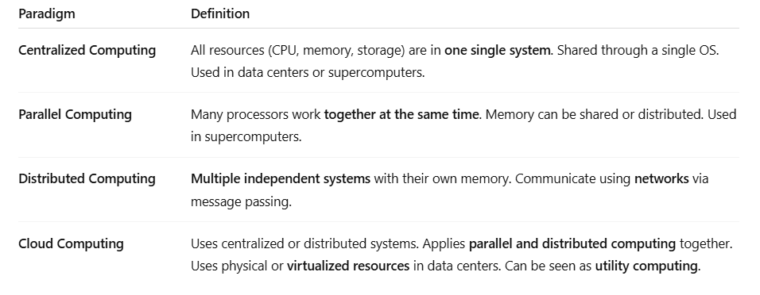
Scalable Computing Over the Internet
Dept of AIML

Slide 20
The Platform Evolution
The general computing trend is to leverage shared web resources and massive amounts of data over the Internet.
• Figure illustrated the evolution of HPC and HTC systems.
• On the HPC side, supercomputers (massively parallel processors or MPPs) are gradually replaced by clusters of cooperative computers out of a desire to share computing resources.
• The cluster is often a collection of homogeneous computing nodes that are physically connected in close range to one another.
Dept of AIML

Slide 21
The Platform Evolution
On the HTC side, peer-to-peer (P2P) networks are
formed for distributed file sharing and content
delivery applications.
• A P2P system is built over many client machines.
– Peer machines are globally distributed in nature.
• P2P, cloud computing, and web service platforms are
more focused on HTC applications than on HPC applications.
• Clustering and P2P technologies lead to the
development of computational grids or data grids
Dept of AIML

Slide 22
High-Throughput Computing
The development of market-oriented high-end computing systems is undergoing a strategic change from an HPC paradigm to an HTC paradigm.
• This HTC paradigm pays more attention to high-flux computing.
The main application for high-flux computing is in Internet
searches and web services by millions or more users simultaneously.
– The performance goal thus shifts to measure high throughput or the number of tasks completed per unit of time.
Dept of AIML

Slide 23
High-Throughput Computing
Focus: Number of jobs per unit time
Metric: Throughput
Applications:
Web search
E-commerce
Social media
Data centers
HTC emphasizes:
Cost efficiency
Energy savings
Reliability
Security
Dept of AIML

Slide 24
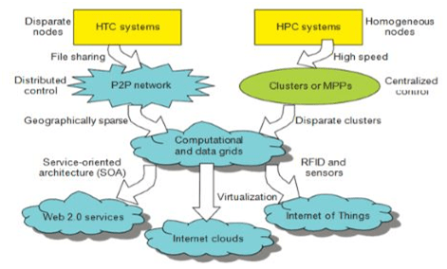
Revisiting - Evolution Toward Parallel, Distributed & Cloud Computing
HPC Side:
Homogeneous nodes
Clusters / MPPs
Centralized control
High-speed interconnects
Dept of AIML

Slide 25
Revisiting - Evolution Toward Parallel, Distributed & Cloud Computing
HTC Side:
P2P networks
Web services
SOA
Cloud computing
Internet of Things
Both converge into:
Computational grids
Internet clouds
Dept of AIML

Slide 26
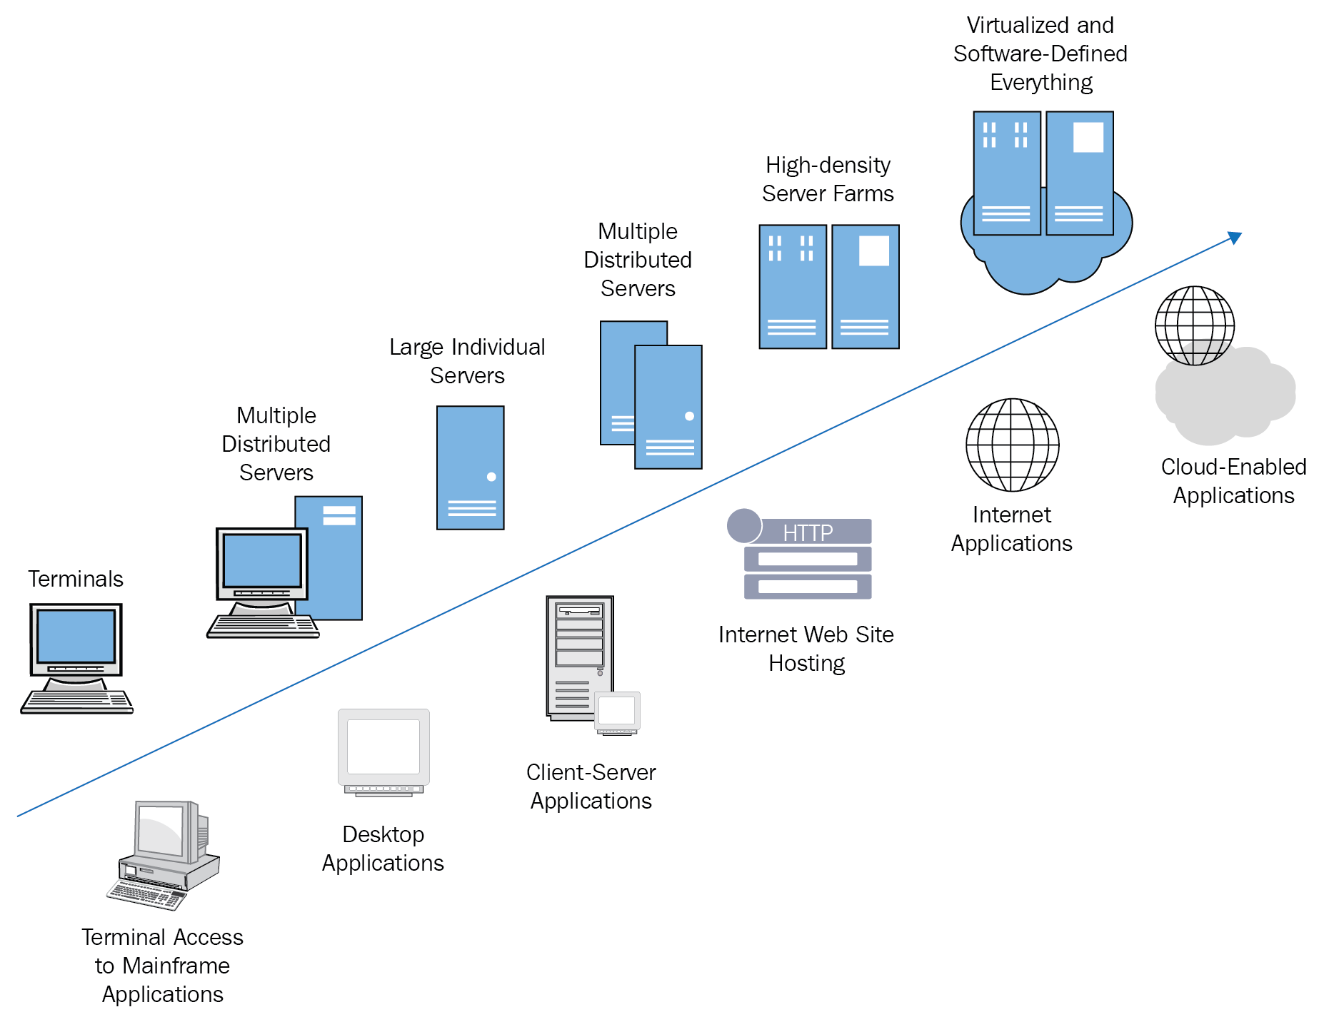
The evolution of cloud computing
Dept of AIML

Slide 27
Three New Computing Paradigms
Service-Oriented Architecture (SOA)
Cloud Computing (via virtualisation)
Internet of Things (IoT)
Important slogans reflecting paradigm shift:
“The network is the computer.”
“The data center is the computer.”
“The cloud is the computer.”
Dept of AIML

Slide 28
Computing Paradigm Distinctions Snap
Centralized Computing
All resources in one physical system
Tightly coupled
Parallel Computing
Multiple processors working simultaneously
Shared memory or message passing
Distributed Computing
Multiple autonomous computers
Connected via network
Communicate through message passing
Cloud Computing
Virtualized resource pool
Delivered as service
Can be centralized or distributed
Dept of AIML

Slide 29
Distributed System Families
Clusters
Computational grids
P2P networks
Internet clouds
Design goals:
Efficiency
Dependability
Adaptation
Flexibility
Dept of AIML

Slide 30
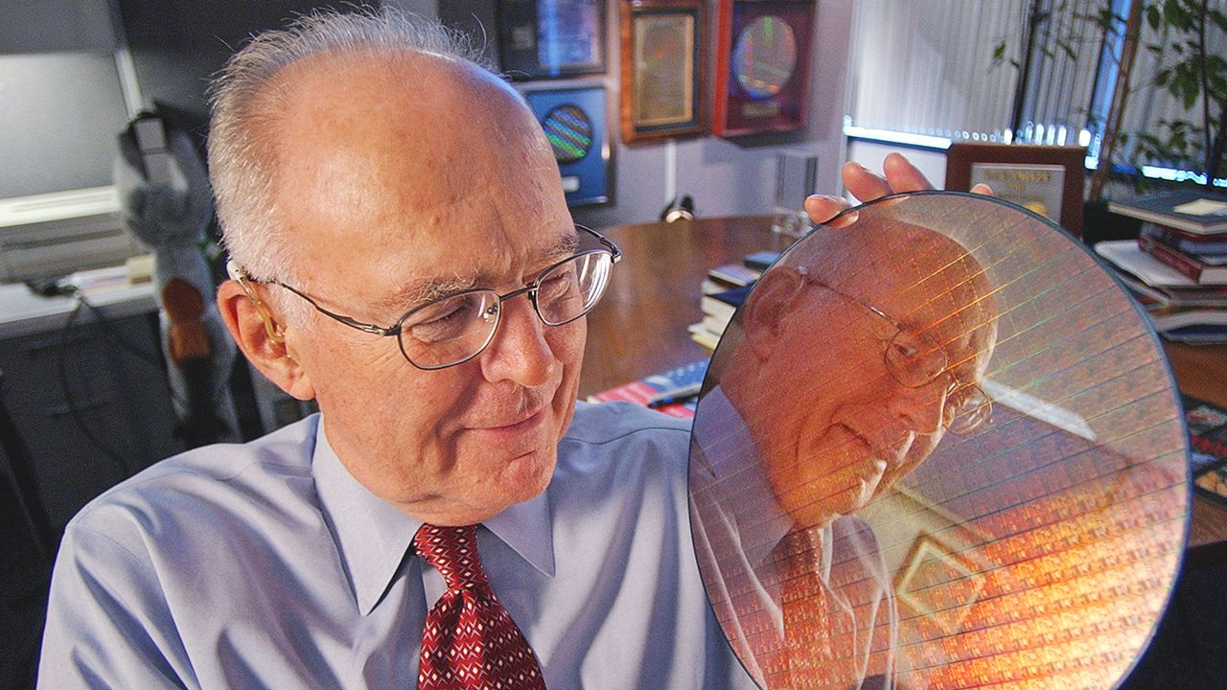
Scalable Computing Trends and New Paradigms
Technology trends influencing distributed systems:
Moore’s Law – Processor speed doubles ~18 months
Moore's Law is the 1965 observation by Intel co-founder Gordon Moore that the number of transistors on a microchip doubles approximately every two years, accompanied by2 decreased costs and increased performance.
Dept of AIML

Slide 31
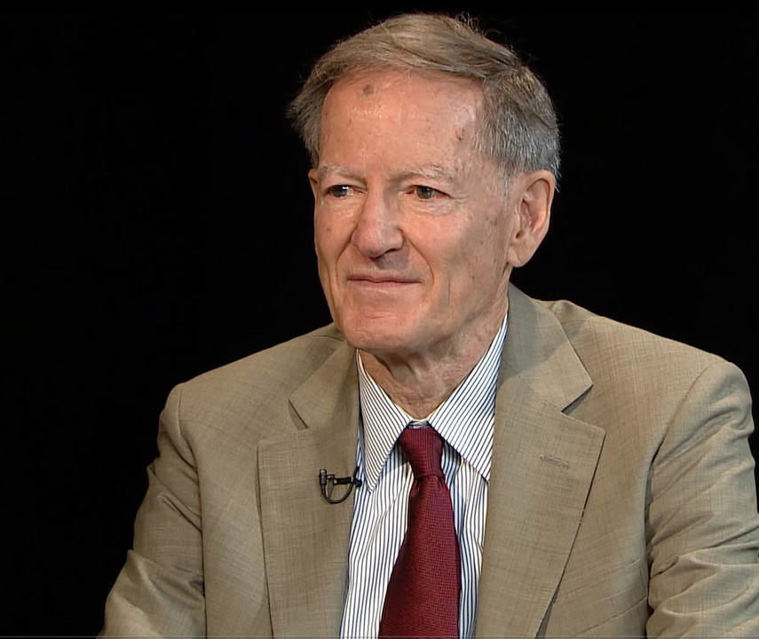
Scalable Computing Trends and New Paradigms
Technology trends influencing distributed systems:
Gilder’s Law – Network bandwidth doubles yearly
Gilder's Law, formulated by futurist George Gilder in the 1990s, states that the total bandwidth of communication systems triples every twelve months, growing at least three times faster than computing power.
Dept of AIML

Slide 32
Degrees of Parallelism
4. Task-Level Parallelism (TLP)
Multicore processors
5. Job-Level Parallelism (JLP)
Distributed systems
Cloud platforms
Parallelism exists at multiple levels:
Bit-Level Parallelism (BLP) 4-bit → 8-bit → 16-bit → 64-bit processors
Instruction-Level Parallelism (ILP)
Pipelining
Superscalar
Branch prediction
Speculative execution
Data-Level Parallelism (DLP)
SIMD
Vector processors
Dept of AIML
Single Instruction, Multiple Data (SIMD)

Slide 33
Degrees of Parallelism
Utility computing:
Resources delivered like electricity
Pay-as-you-use model
Characteristics:
Ubiquitous
Reliable
Scalable
Autonomic
SLA-based
Cloud computing extends utility computing.
Dept of AIML

Slide 34
Internet of Things (IoT) and Cyber-Physical Systems
Internet of Things (IoT) Networked interconnection of everyday objects.
Enabled by:
RFID
Sensors
GPS
IPv6 (2¹²⁸ addresses)
Communication types:
H2H (Human-to-Human)
H2T (Human-to-Thing)
T2T (Thing-to-Thing)
Scale:
100 trillion objects
Thousands of connected devices per person
Dept of AIML

Slide 35
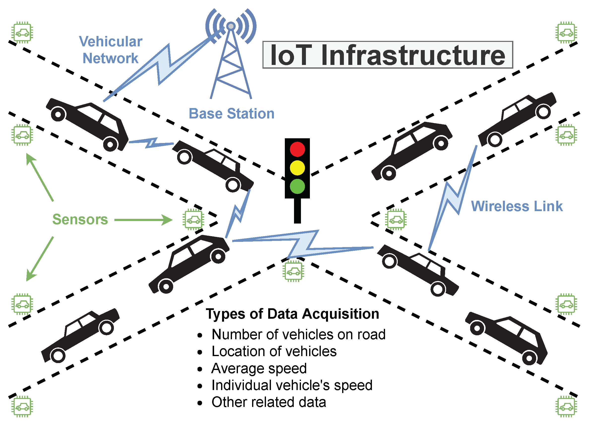
Internet of Things (IoT) and Cyber-Physical Systems
Cyber-Physical Systems (CPS)
CPS integrates:
Computation
Communication
Control
IoT → Connectivity CPS → Intelligent feedback between physical & cyber world
Dept of AIML

Slide 36
Technologies for Network-Based Systems
Multicore CPUs and Multithreading
Modern CPUs:
Dual-core, quad-core, many-core
Private L1 cache per core
Shared L2/L3 cache
Multithreading types:
Superscalar
Fine-grain multithreading
Coarse-grain multithreading
Dual-core CMP
Simultaneous multithreading (SMT)
Clock frequency limited due to:
Heat
Power consumption
Dept of AIML

Slide 37
Multicore CPUs and Multithreading Technologies
Both multi-core CPU and many-core GPU processors can handle multiple instruction threads at different magnitudes today.
Figure 1.5 shows the architecture of a typical multicore processor.
Each core is essentially a processor with its own private cache (L1 cache).
Multiple cores are housed in the same chip with an L2 cache that is shared by all cores.
Dept of AIML

Slide 38
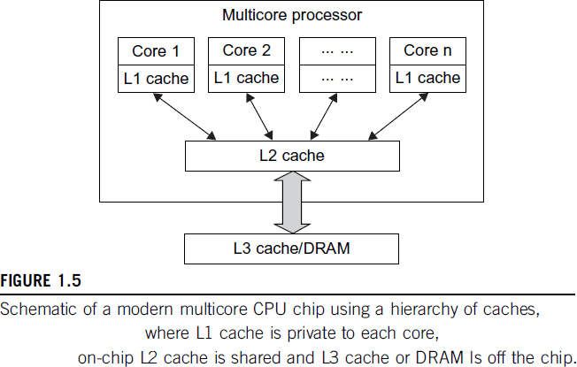
Multicore CPUs and Multithreading Technologies
Dept of AIML

Slide 39
Multicore CPUs and Multithreading Technologies
In the future, multiple CMPs could be built on the same CPU chip with even the L3 cache on the chip.
Multicore and multithreaded CPUs are equipped with many high- end processors, including the Intel i7, Xeon, AMD Opteron, Sun Niagara, IBM Power 6, and X cell processors.
Each core could be also multithreaded.
For example, the Niagara II is built with eight cores with eight threads handled by each core.
Dept of AIML
CMP - Chip Multiprocessor

Slide 40
Multicore CPU and Many-Core GPU Architectures
CPU has reached its limit in terms of exploiting massive DLP due to the aforementioned memory wall problem.
This has triggered the development of many-core GPUs with hundreds or more thin cores.
Both IA-32((Intel Architecture) and IA-64 instruction set architectures are built into commercial CPUs.
Now, x-86 processors have been extended to serve HPC and HTC systems in some high-end server processors.
Dept of AIML

Slide 41
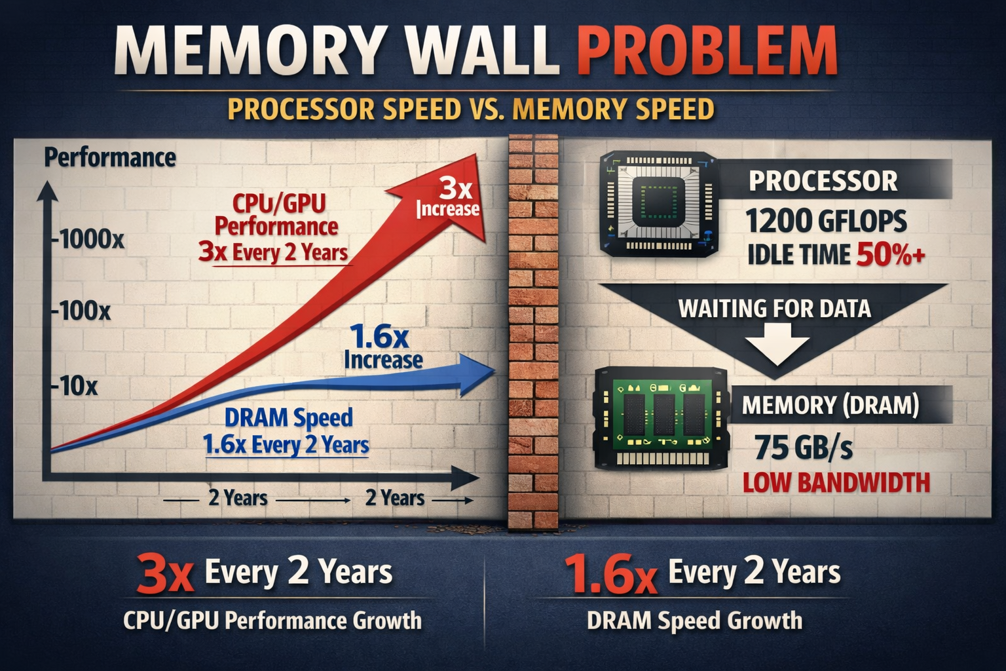
Multicore CPU and Many-Core GPU Architectures
Dept of AIML

Slide 42
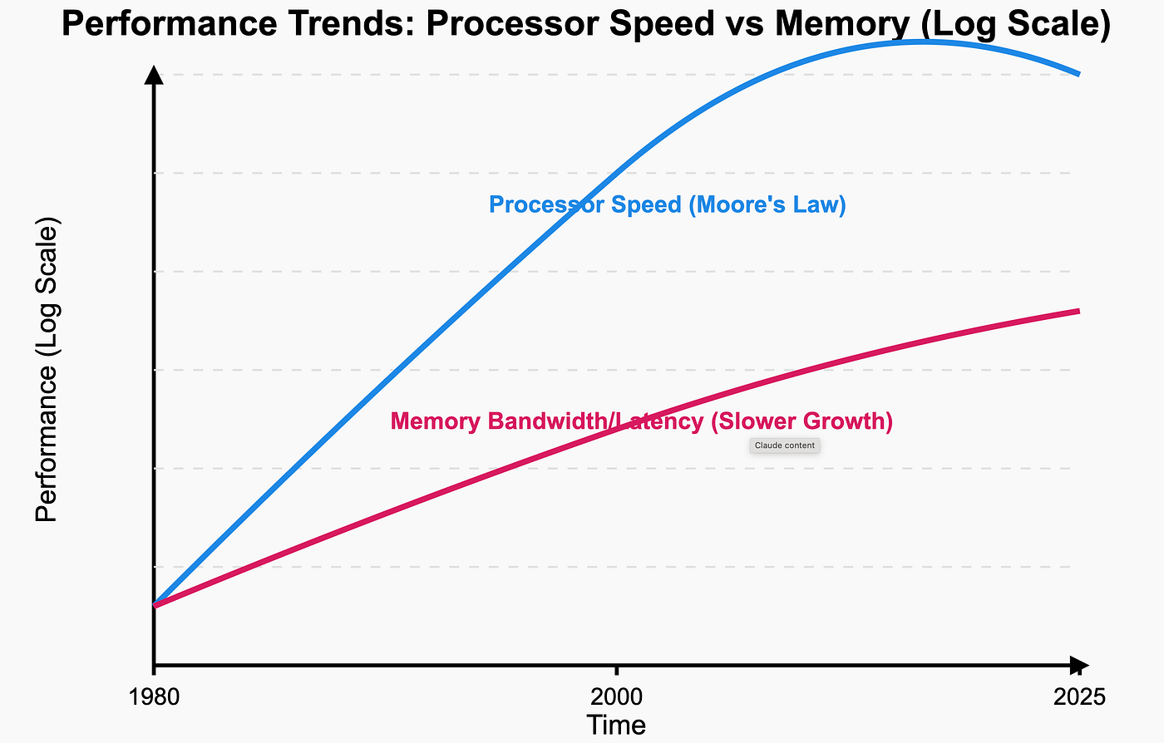
Multicore CPU and Many-Core GPU Architectures
Dept of AIML

Slide 43
Multicore CPU and Many-Core GPU Architectures
Many RISC(Reduced Instruction Set Computer) processors have been replaced with multicore x-86 processors and many core GPUs in the Top 500 systems.
This trend indicates that x-86 upgrades will dominate in data centers and supercomputers.
The GPU also has been applied in large clusters to build supercomputers in MPPs.
In the future, the processor industry is also keen to develop asymmetric or heterogeneous chip multiprocessors that can house both fat CPU cores and thin GPU cores on the same chip.
Dept of AIML

Slide 44
Multithreading Technology
Consider in Figure 1.6 the dispatch of five independent threads of instructions to four pipelined data paths (functional units) in each of the following five processor categories, from left to right:
a four-issue superscalar processor,
a fine-grain multithreaded processor,
a coarse- grain multithreaded processor,
a two-core CMP
a simultaneous multithreaded (SMT) processor.
Dept of AIML

Slide 45
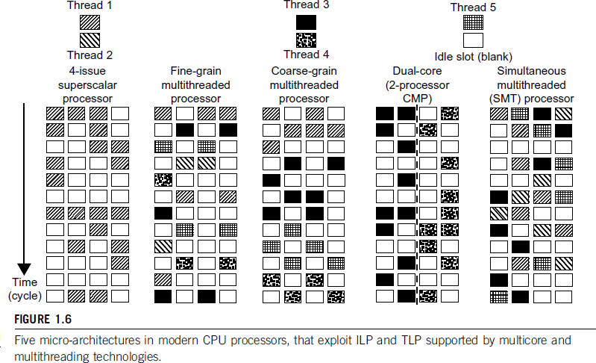
Multithreading Technology
Dept of AIML

Slide 46
Multithreading Technology
The superscalar processor is single-threaded with four functional units.
Each of the three multithreaded processors is four-way multithreaded over four functional data paths.
In the dual-core processor, assume two processing cores, each a single-threaded two-way superscalar processor
Dept of AIML

Slide 47
GPU Computing to Exa-scale and Beyond
Unlike CPUs, GPUs have a throughput architecture that exploits massive parallelism by executing many concurrent threads.
Slowly, instead of executing a single long thread in a conventional microprocessor very quickly.
Lately, parallel GPUs or GPU clusters have been garnering a lot of attention against the use of CPUs with limited parallelism.
General-purpose computing on GPUs, known as GPGPUs, have appeared in the HPC field.
Dept of AIML

Slide 48
GPU Computing to Exa-scale and Beyond
Early GPUs functioned as coprocessors attached to the CPU.
Today, the NVIDIA GPU has been upgraded to 128 cores on a
single chip.
Furthermore, each core on a GPU can handle eight threads of instructions.
This translates to having up to 1,024 threads executed concurrently on a single GPU.
This is true massive parallelism, compared to only a few threads that can be handled by a conventional CPU.
The CPU is optimized for latency caches, GPU is optimized to deliver much higher throughput
Dept of AIML

Slide 49
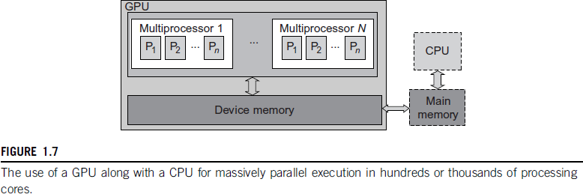
GPU Programming Model
Figure 1.7 shows the interaction between a CPU and GPU in performing parallel execution of floating-point operations concurrently.
The CPU is the conventional multicore processor with limited parallelism to exploit.
Dept of AIML

Slide 50
GPU Programming Model
The GPU has a many-core architecture that has hundreds of simple processing cores organised as multiprocessors. Each core can have one or more threads.
Essentially, the CPU’s floating-point kernel computation role is largely offloaded to the many-core GPU.
The CPU instructs the GPU to perform massive data processing.
The bandwidth must be matched between the on-board main memory and the on-chip GPU memory.
This process is carried out in NVIDIA’s CUDA programming using the GeForce 8800 or Tesla and Fermi GPUs.
Dept of AIML

Slide 51
System-Area Interconnects
All three types of networks often appear in a large cluster built with commercial network components.
If no large distributed storage is shared, a small cluster could be built with a multiport Gigabit Ethernet switch plus copper cables to link the end machines.
All three types of networks are commercially available.
Dept of AIML

Slide 52
System-Area Interconnects
The nodes in small clusters are mostly interconnected by an
Ethernet switch or a local area network (LAN).
As Figure 1.11 shows, a LAN typically is used to connect client hosts to big servers.
A storage area network (SAN) connects servers to network storage such as disk arrays.
Network attached storage (NAS) connects client hosts directly to the disk arrays.
Dept of AIML

Slide 53
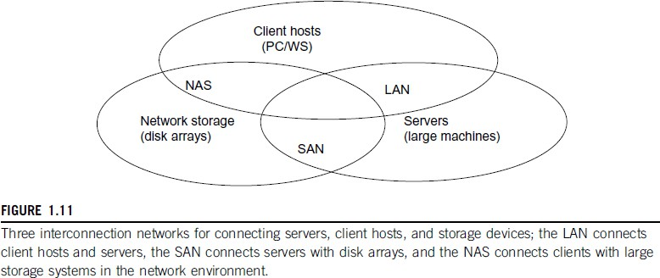
System-Area Interconnects
Dept of AIML

Slide 54
Virtual Machines and Virtualization Middleware
A conventional computer has a single OS image. This offers a rigid architecture that tightly couples application software to a specific hardware platform.
Some software running well on one machine may not be executable on another platform with a different instruction set under a fixed OS.
Virtual machines (VMs) offer novel solutions to underutilized resources, application inflexibility, software manageability, and security concerns in existing physical machines.
Dept of AIML

Slide 55
Virtual Machines and Virtualization Middleware
Today, to build large clusters, grids, and clouds, we need to access large amounts of computing, storage, and networking resources in a virtualized manner.
We need to aggregate those resources, and hopefully, offer a single system image.
In particular, a cloud of provisioned resources must rely on virtualization of processors, memory, and I/O facilities dynamically.
Figure 1.12 illustrates the architectures of three VM configurations.
Dept of AIML

Slide 56
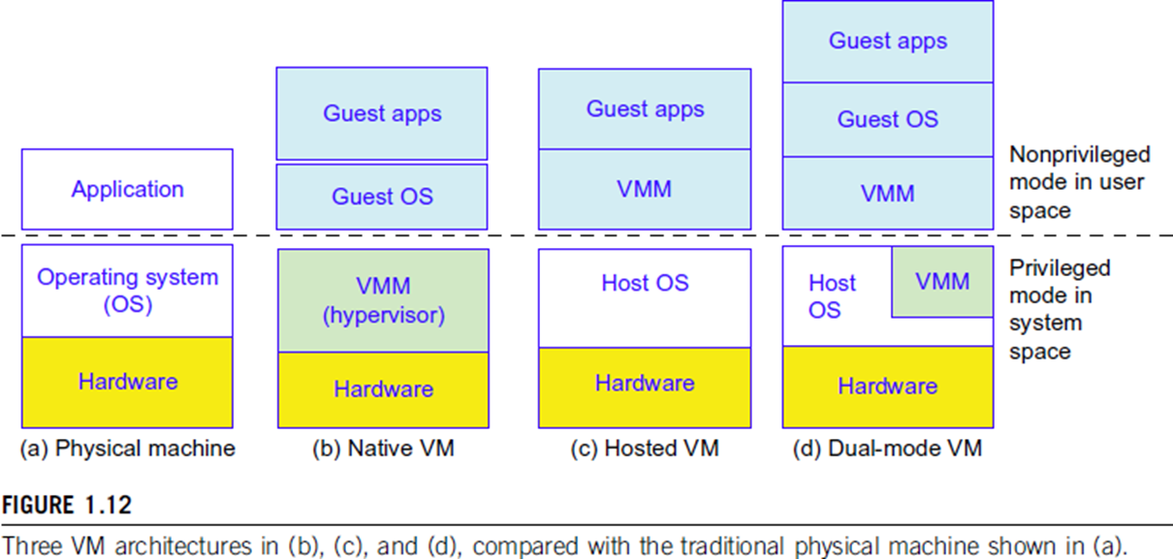
Virtual Machines and Virtualization Middleware
Dept of AIML

Slide 57
VM Primitive Operations
The VMM provides the VM abstraction to the guest OS. With full virtualization, the VMM exports a VM abstraction identical to the physical machine so that a standard OS such as Windows 2000 or Linux can run just as it would on the physical hardware.
Low-level VMM operations are indicated by Mendel Rosenblum [41] and illustrated in Figure 1.13.
First, the VMs can be multiplexed between hardware machines, as shown in Figure 1.13(a).
Second, a VM can be suspended and stored in stable storage, as shown in Figure 1.13(b).
Third, a suspended VM can be resumed or provisioned to a new hardware platform, as shown in Figure 1.13(c).
Finally, a VM can be migrated from one hardware platform to another, as shown in Figure 1.13(d).
Dept of AIML

Slide 58
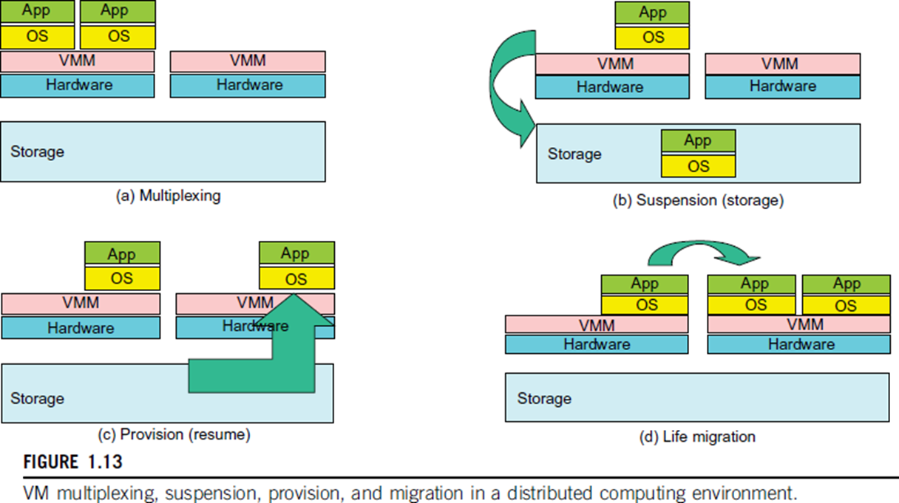
VM Primitive Operations
Dept of AIML

Slide 59
SYSTEM MODELS FOR DISTRIBUTED AND CLOUD COMPUTING
A distributed system is a collection of independent computers that appear to users as a single coherent system or Single-System Image concept.
Key Characteristics
Resource sharing
Concurrency
Scalability
Fault tolerance
Transparency
Dept of AIML

Slide 60
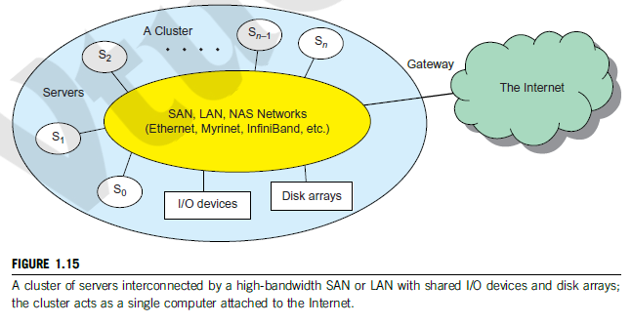
Cluster Computing Model
A cluster is a collection of interconnected homogeneous machines working as a single system.
Characteristics
High-speed LAN
Centralized scheduling
Single system image (SSI)
Used in HPC
Applications
Scientific simulations
Weather forecasting
Bioinformatics
Dept of AIML

Slide 61
Grid Computing Model
A geographically distributed collection of heterogeneous resources across multiple organizations.
Characteristics
Virtual Organizations (VO)
Middleware coordination
Decentralised control
Resource federation
Dept of AIML

Slide 62
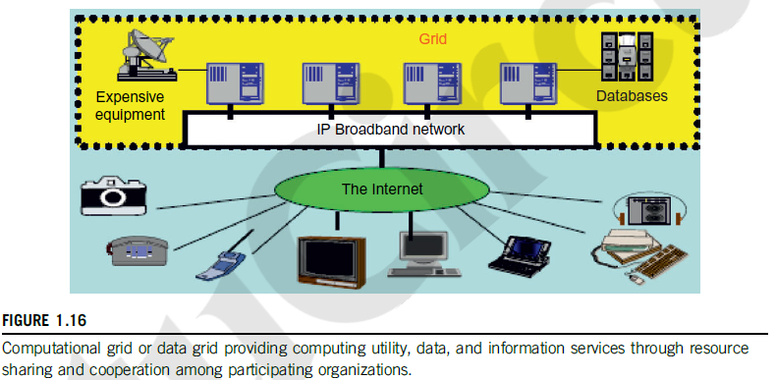
Grid Computing Model
Dept of AIML

Slide 63
Key Difference from Cluster with Grid
Cluster | Grid
Same location | Distributed
Homogeneous | Heterogeneous
Central control | Multi-admin
Dept of AIML

Slide 64
Peer-to-Peer (P2P) Model
Features
No central controller
Each node = client + server
Dynamic joining/leaving
Applications
File sharing
Blockchain
Dept of AIML

Slide 65
Cloud Computing Model
Cloud Computing over the Internet:
A cloud is a pool of virtualised computer resources. A cloud can host a variety of different workloads, including batch-style backend jobs and interactive and user-facing applications.
Essential Characteristics
On-demand self-service
Resource pooling
Rapid elasticity
Measured service
Broad network access
Dept of AIML

Slide 66
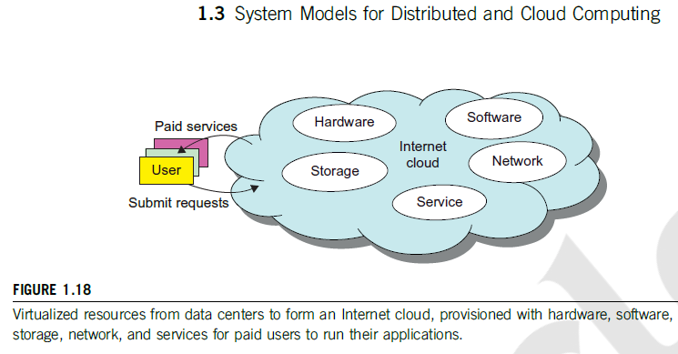
Cloud Computing Model
Dept of AIML

Slide 67
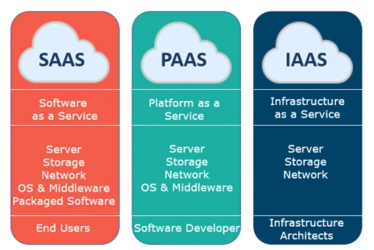
Cloud Computing Model
Model | Description
IaaS | Virtual machines, storage
PaaS | Development platform
SaaS | End-user applications
Dept of AIML

Slide 68
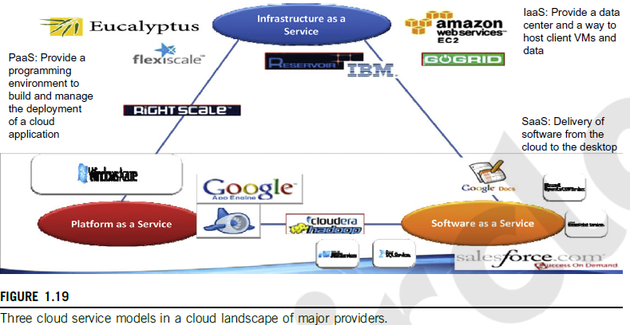
Cloud Computing Model
Dept of AIML

Slide 69
Data Center Model
The following list highlights eight reasons to adapt the cloud for upgraded Internet applications and web services.
1. Desired location in areas with protected space and higher energy efficiency
2. Sharing of peak-load capacity among a large pool of users, improving overall utilization
3. Separation of infrastructure maintenance duties from domain-specific application development
4. Significant reduction in cloud computing cost, compared with traditional computing paradigms
5. Cloud computing programming and application development
6. Service and data discovery and content/service distribution
7. Privacy, security, copyright, and reliability issues
8. Service agreements, business models, and pricing policies
Dept of AIML

Slide 70
SOFTWARE ENVIRONMENTS FOR DISTRIBUTED SYSTEMS AND CLOUDS
Large centralized infrastructure
Thousands of servers
Virtualized environment
Energy-aware design
Dept of AIML

Slide 71
Virtualization – Core Technology
Definition
Virtualisation allows multiple virtual machines (VMs) to run on the same hardware.
Dept of AIML

Slide 72
Service-Oriented Architecture (SOA)
Definition
SOA is an architectural model where software components (services) communicate over a network using well-defined interfaces.
Dept of AIML
Technology | Entity Type
Web Services / Grids | Service
Java | Object
CORBA | Distributed Object

Slide 73
Layered Architecture for Web Services & Grids
Definition
SOA builds on traditional networking layers and adds higher-level service abstractions.
OSI Layers (Networking Foundation)
Physical
Data Link
Network (IP)
Transport (TCP/UDP)
Session
Presentation
Application
Dept of AIML

Slide 74
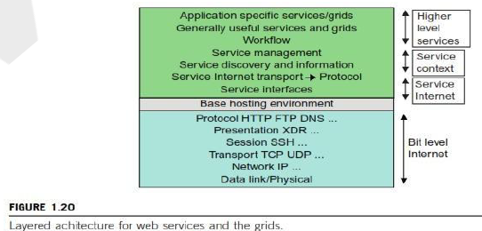
Layered Architecture for Web Services & Grids
Distributed computing builds on the OSI model, adding layers for service interfaces, workflows, and management.
Dept of AIML

Slide 75
Layered Architecture for Web Services & Grids
Definition
SOA builds on traditional networking layers and adds higher-level service abstractions.
OSI Layers (Networking Foundation)
Physical
Data Link
Network (IP)
Transport (TCP/UDP)
Session
Presentation
Application
Dept of AIML

Slide 76
Web Services and Tools
Service Architecture in Distributed Systems Loose coupling between components
Supports heterogeneous systems
Easier interoperability across platforms
Two Main Service Architectures
Web Services (SOAP-based)
REST (Representational State Transfer)
Dept of AIML

Slide 77
Web Services and Tools
Web Services Characteristics
Fully specifies service environment
Uses SOAP messages
SOAP carries:
Protocol rules
Message structure
Communication details
Limitation
Complex protocol
Difficult implementation (e.g., Apache Axis)
SOAP (Simple Object Access Protocol)
Dept of AIML

Slide 78
REST Architecture and Distributed Composition
REST Approach
Emphasizes simplicity
Minimal message header
Most information stored in message body
Key Features
Lightweight communication
Faster development
Suitable for rapid technology environments
Dept of AIML

Slide 79
Distributed Application Composition
Services integrated to build composite applications
Examples:
Java RMI – remote method calls
CORBA RPC – distributed object communication
Conceptual View
Sensors → Data producers
Grids/Clouds → Collections of services processing data
CORBA (Common Object Request Broker Architecture) , Remote Procedure Calls (RPC), SOAP (Simple Object Access Protocol)
Dept of AIML

Slide 80
Introduction to Distributed Operating Systems
A Distributed Operating System (DOS) is an operating system that manages a collection of independent computers and makes them appear to users as a single unified computing system.
A distributed OS ensures:
Transparent resource sharing
Coordinated execution of processes
Efficient communication between nodes
High availability and reliability
cooperate through software layers such as operating systems and middleware.
Dept of AIML

Slide 81
Parallel and Distributed Programming Models
Message Passing Interface (MPI) : Most widely used programming model for parallel and distributed systems.
MapReduce Programming Model :
Map: Processes input data into intermediate key–value pairs.
Reduce: Aggregates intermediate results to produce final output.
Bigtable Data Model : Handles large structured datasets across thousands of servers.
Dept of AIML

Slide 82
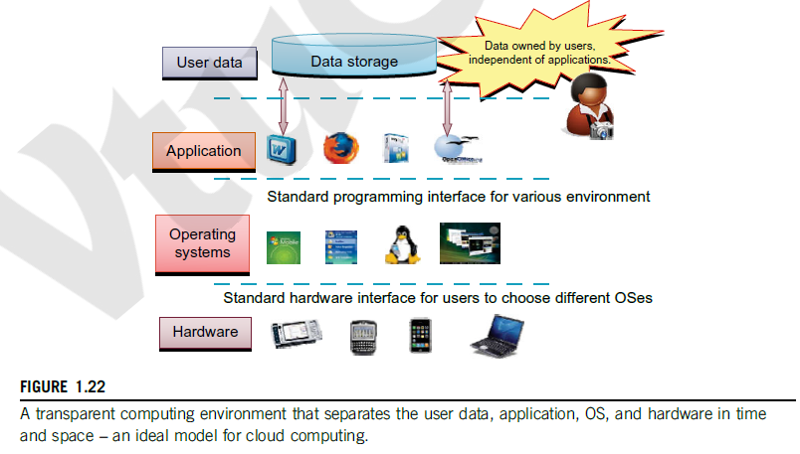
Parallel and Distributed Programming Models
Dept of AIML

Slide 83
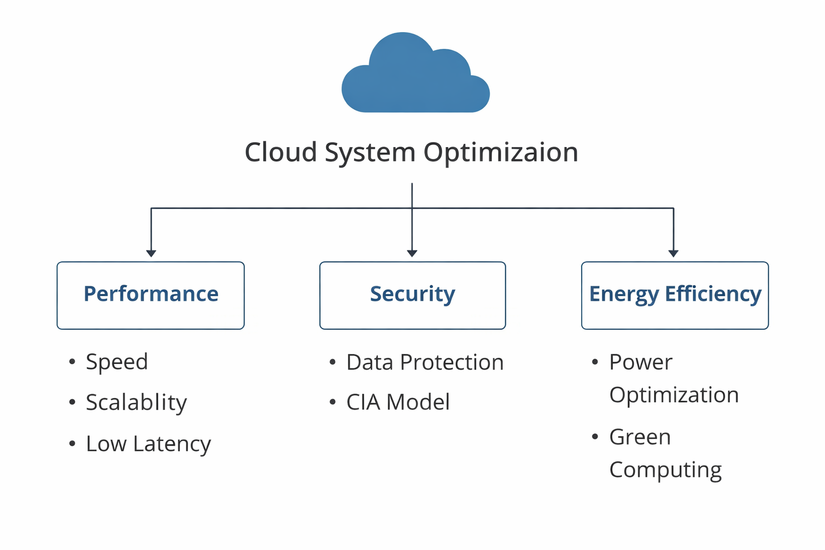
PERFORMANCE, SECURITY, AND ENERGY EFFICIENCY
Dept of AIML

Slide 84
PERFORMANCE, SECURITY, AND ENERGY EFFICIENCY
Performance
Performance in cloud computing refers to the ability of cloud systems to process tasks efficiently while delivering high speed, low latency, and high throughput to users.
Scalability: Ability to handle increasing workloads by adding resources (VMs, containers, servers).
Throughput: Number of tasks or requests processed per unit time.
Latency: Time taken to respond to a user request.
Resource Utilization: Efficient use of CPU, memory, storage, and network resources.
Dept of AIML

Slide 85
PERFORMANCE, SECURITY, AND ENERGY EFFICIENCY
Security
Security in cloud computing refers to the protection of cloud resources, applications, and data from unauthorized access, attacks, and data breaches.
Security focuses on three major principles (CIA triad):
Confidentiality: Protecting data from unauthorized access using encryption and authentication.
Integrity: Ensuring that data remains accurate and unaltered.
Availability: Ensuring cloud services remain accessible even during failures or attacks.
Dept of AIML

Slide 86
PERFORMANCE, SECURITY, AND ENERGY EFFICIENCY
Energy Efficiency
Energy efficiency refers to the ability of cloud systems and data centers to deliver high computing performance while minimizing power consumption and environmental impact.
Cloud data centers consume significant electricity due to:
Large numbers of servers
Cooling systems
Storage infrastructure
Networking equipment
Example: Large cloud providers design green data centres to optimize cooling and energy usage.
Dept of AIML

Slide 87
Scalability versus OS Image Count in Distributed Systems
Scalable performance in distributed systems means that system performance improves when additional resources (processors, memory, storage, or I/O channels) are added. The OS image count represents the number of independent operating system instances running across nodes in distributed architectures such as SMP, NUMA, clusters, grids, P2P networks, and clouds.
Dept of AIML

Slide 88
SMP (Symmetric Multiprocessor) Systems
Single system image (one OS) controlling multiple processors.
Shared memory architecture.
Scalability is limited by hardware packaging and interconnect.
Typically supports hundreds of processors in a single node
Dept of AIML

Slide 89
NUMA (Non-Uniform Memory Access) Systems
Built from multiple SMP nodes with distributed shared memory.
Can run multiple OS images.
Scales to thousands of processors using MPI communication.
Example:
2,048 processors
32 SMP nodes
32 OS images
Dept of AIML

Slide 90
Cluster Systems
Consist of multiple loosely coupled computing nodes.
Each node runs its own OS image.
Much higher scalability than NUMA systems.
Nodes may be SMP or multicore servers.
Dept of AIML

Slide 91
Cloud Computing Systems
Often implemented as virtualized clusters.
Large number of Virtual Machines (VMs) each with its own OS image.
By 2010, large cloud systems could scale to thousands of VMs.
Dept of AIML

Slide 92
Grid Computing Systems
Integrates resources across organisations.
Nodes may be:
clusters
supercomputers
mainframes
massively parallel processors (MPP)
The number of OS images is much smaller than the total number of processors
Dept of AIML

Slide 93
Peer-to-Peer (P2P) Networks
Each peer node runs its own OS instance.
Extremely scalable.
Can reach millions of independent nodes.
Dept of AIML

Slide 94
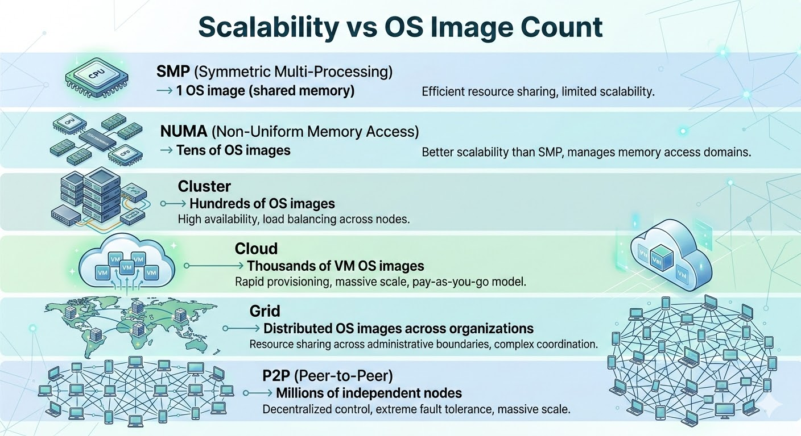
Dept of AIML

Slide 95
Thank you
Dept of AIML

